Slide 1
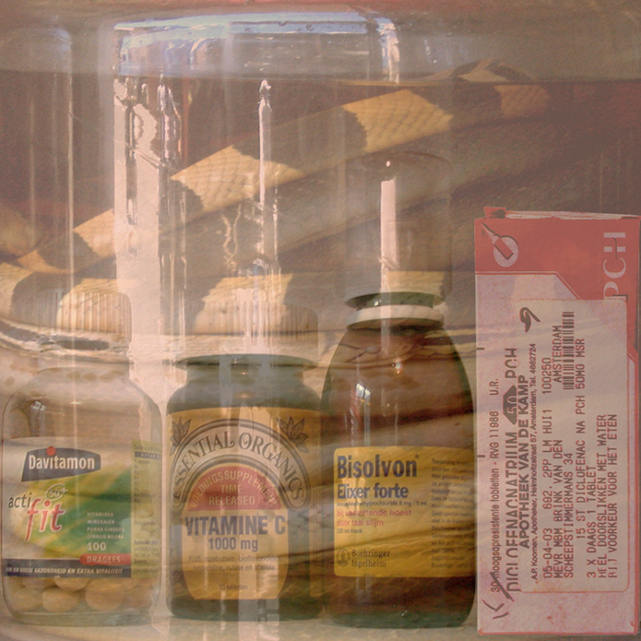
AI and Medicine (health/care)
World Academy of Art and Science
Sally Wyatt, 17 October 2024
https://sallywyatt.nl

Slide 2
Recurring claims
New, exciting & innovative
Transforming relationships between patients & healthcare professionals
Empowering patients (informed vs. compliant)
Death of distance
Improve efficiency & reduce costs as solution to ageing & mobile population
Data increasingly the basis for medicine & healthcare

Slide 3
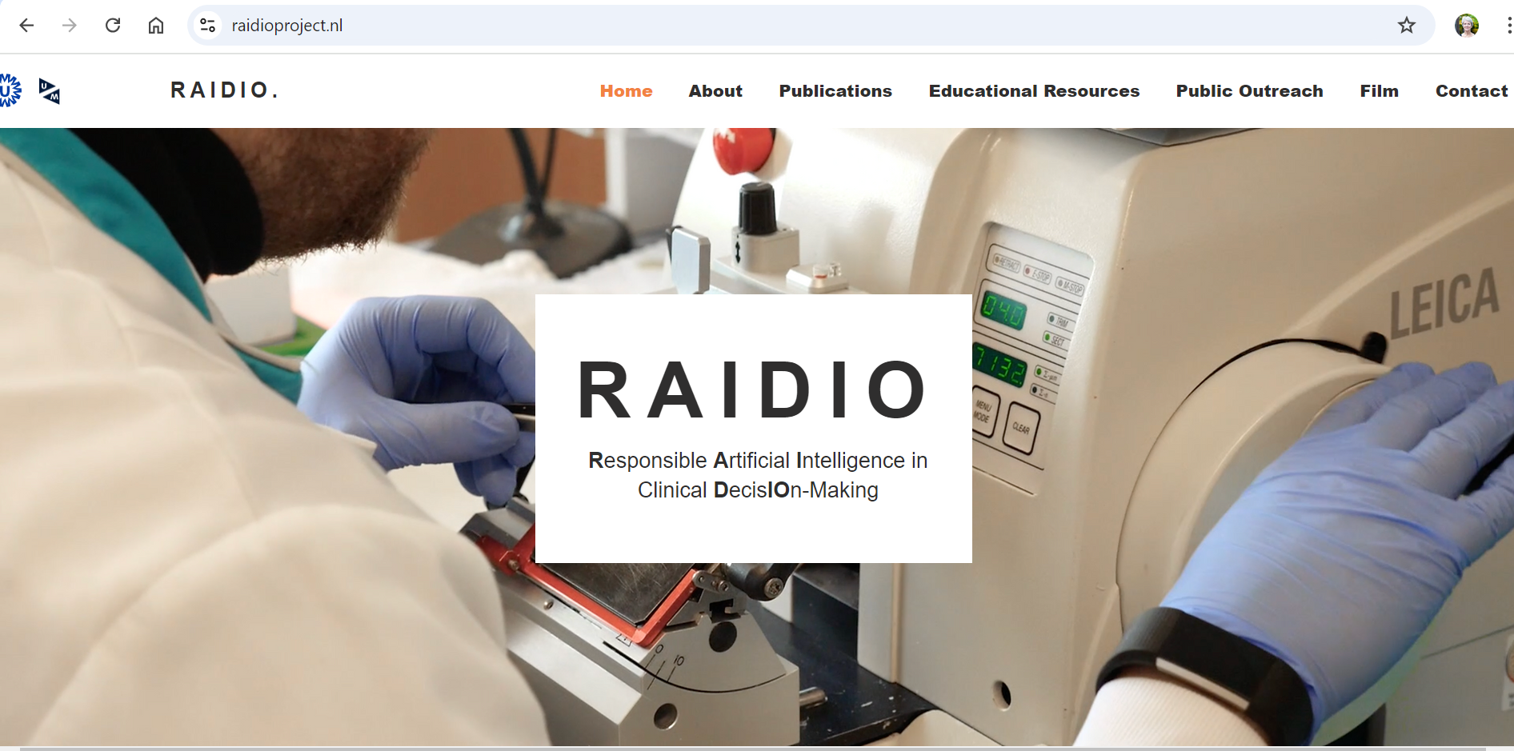
How can AI be responsibly used and integrated in image-based medicine?

Slide 4
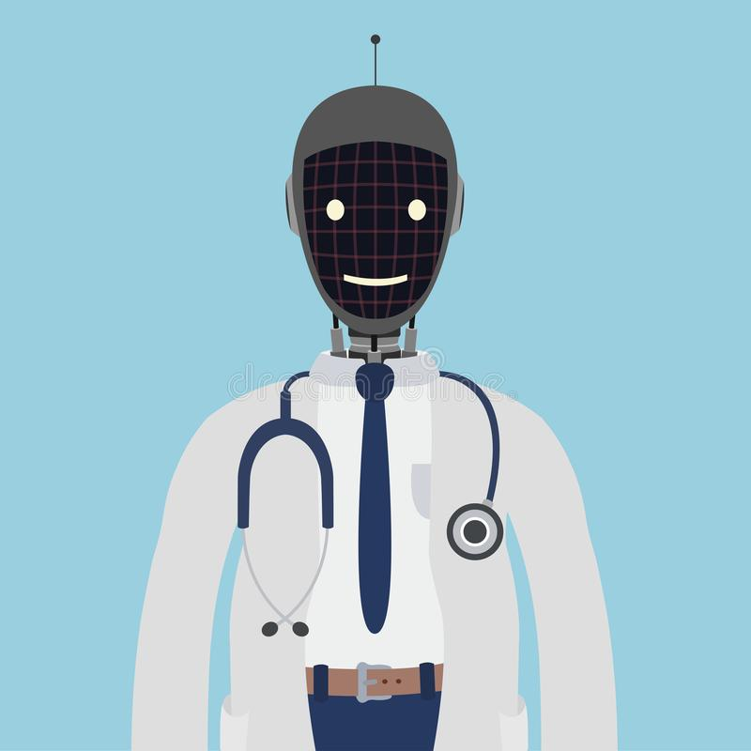
Examples of popular media reports on AI “beating” medical professionals

Slide 5
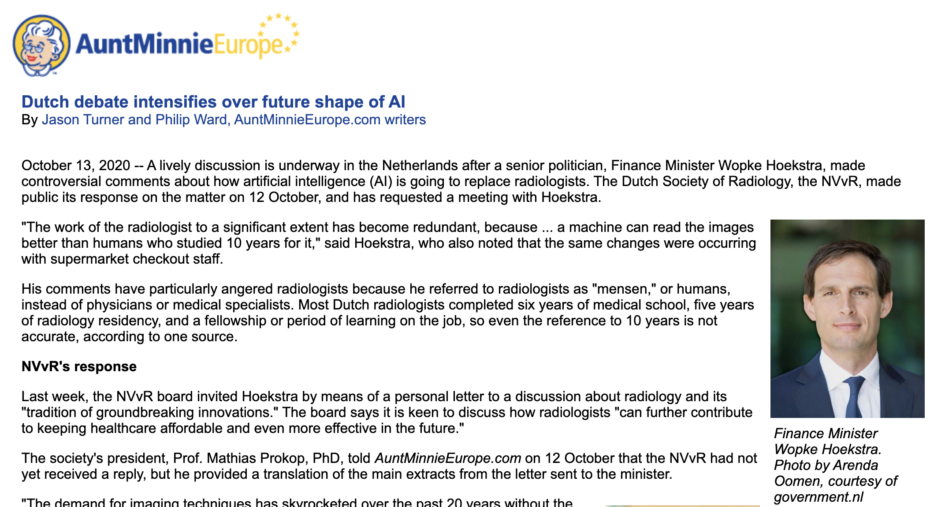
Nobody knows exactly how AI will develop. But it will have the power to drastically change society and the way we work, whether it is about shop counters that will no longer be staffed, or about the work of the radiologist who has to a large extent become obsolete because a machine can read those pictures better than a human who studied them for ten years (…)
Wopke Hoekstra, 1 October 2020 (Prinsjesdag).

Slide 6
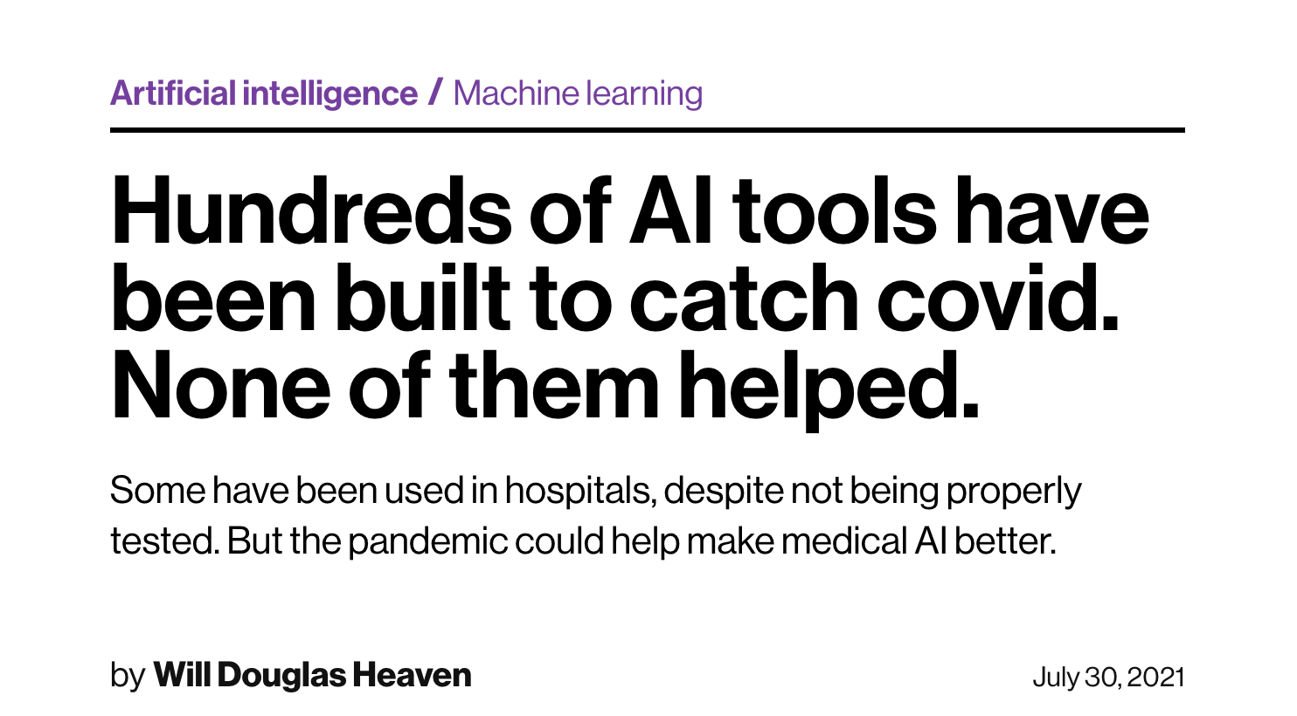
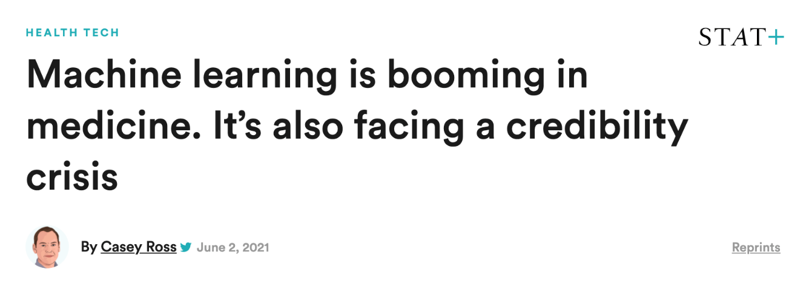

Slide 7
What is often overlooked
Complex networks of policy & practice
AI can be many things, not singular
Appraisal & management of risk & uncertainty
Importance of local social & political contexts of use
Costs (economic and environmental)
Changing relationships of trust and responsibility
Some people are ill

