Slide 1
Ways of Knowing
LECTURE 6
GARRY JACOBS

Slide 2
Human Capacity for Knowledge
All human accomplishment is made possible by our capacity to observe, study, record, reason, exchange and transmit knowledge from person to person, place to place, generation to generation

Slide 3
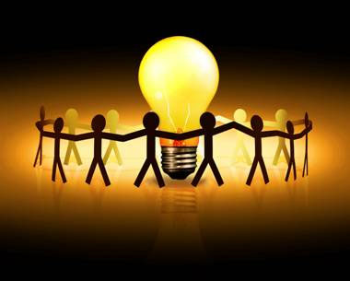
Knowledge is Power
As is the consciousness, so is the power
Limited knowledge means limited power of accomplishment

Slide 4
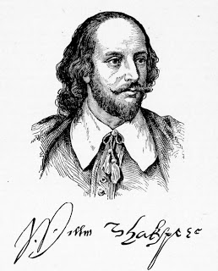
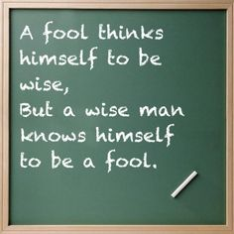
Human Ignorance
Achievements of our science are all the more remarkable when you consider how ignorant we actually are
Our ignorance arises from the fundamental nature of mind
Act V, Scene I

Slide 5
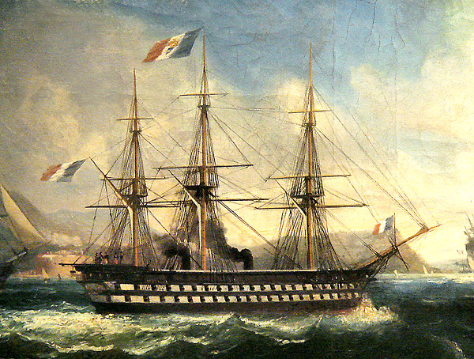
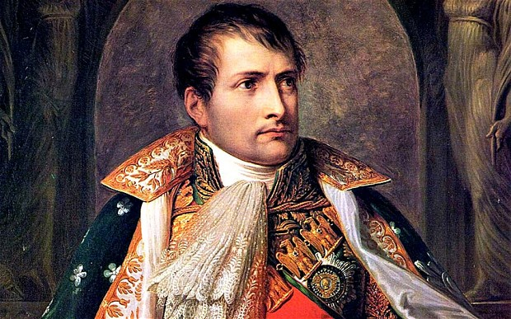
Early estimation of the Steamship
“How, sir, would you make a ship sail against the wind and currents by lighting a bonfire under her deck? I pray you, excuse me, I have not the time to listen to such nonsense.”
– Napoleon

Slide 6
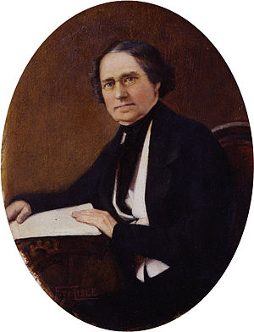
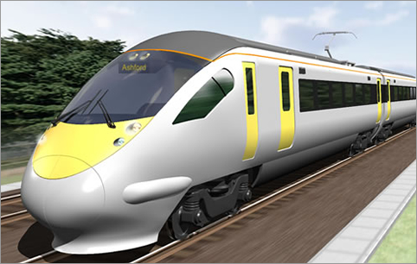
Future of the Railways
“Rail travel at high speed is not possible because passengers, unable to breathe, would die of asphyxia.”
— Dionysius Lardner Science writer and Academic (1828)

Slide 7
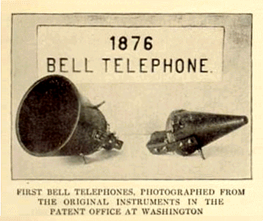
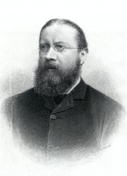
Telephone
“This 'telephone' has too many shortcomings to be seriously considered as a means of communication. The device is inherently of no value to us."
– Western Union Internal Memo (1876)
“The Americans have need of the telephone, but we do not. We have plenty of messenger boys.”
– Sir William Preece Chief Engineer of the British Post Office (1878)

Slide 8
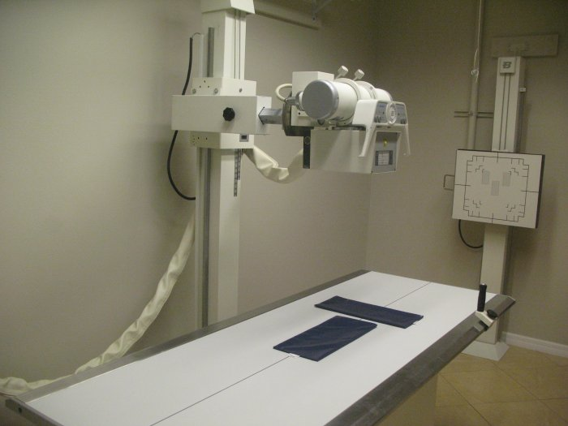
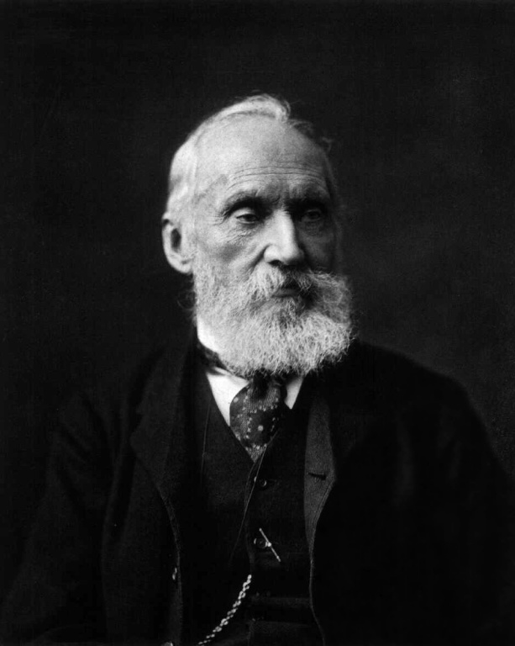
Discovery of X-rays
“X-rays will prove to be a hoax.”
– Lord Kelvin President of the Royal Society (1883)

Slide 9
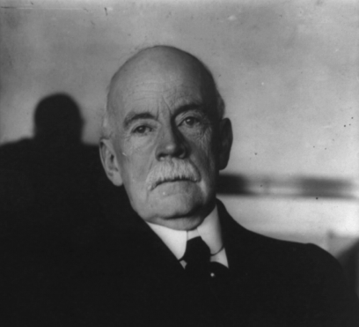
Inventions

Slide 10
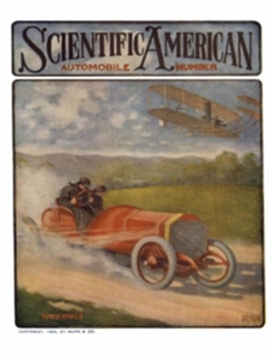
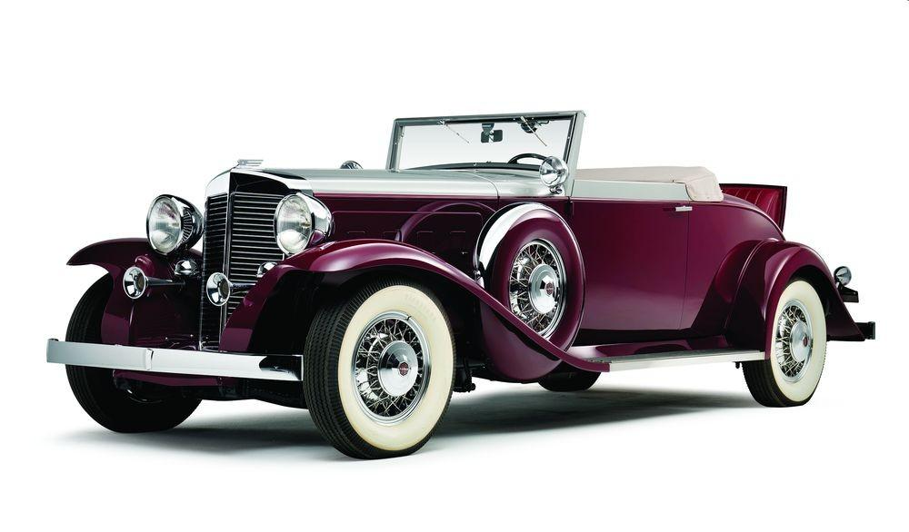
Automobile
“The automobile has practically reached the limit of its development.”
(1909)

Slide 11
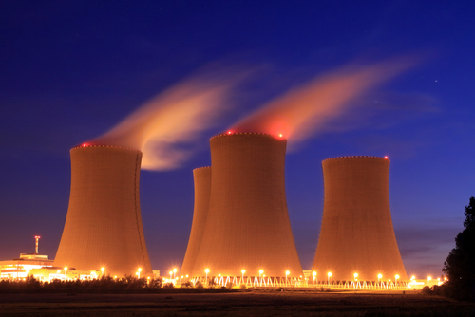
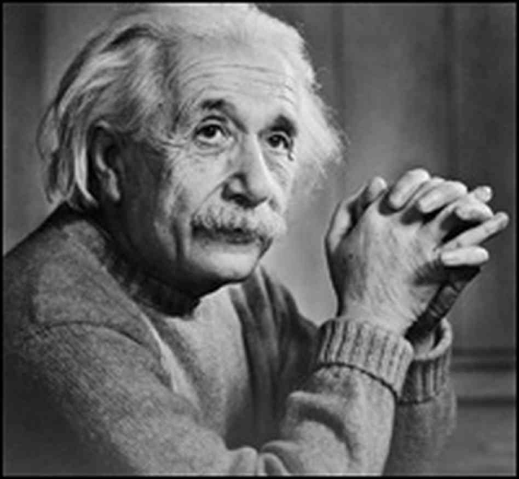
Nuclear Energy
"There is not the slightest indication that nuclear energy will ever be obtainable. It would mean that the atom would have to be shattered at will."
– Albert Einstein, 1932

Slide 12
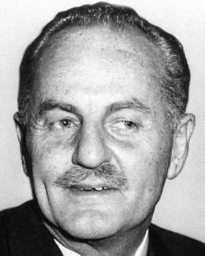
Television
"Television won't last because people will soon get tired of staring at a plywood box every night."
– Darryl Zanuck, Movie Producer, 20th Century Fox, 1946

Slide 13
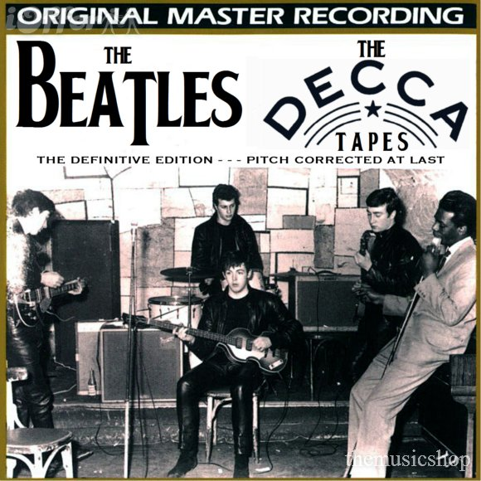
Beatles
"We don't like their sound, and guitar music is on the way out."
– Decca Recording Company on declining to sign the Beatles, 1962

Slide 14
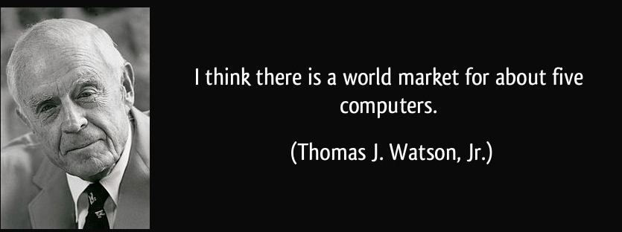
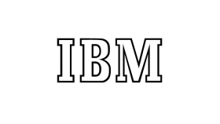
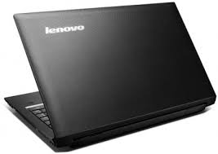
Future of Computer
President, IBM (1943)

Slide 15
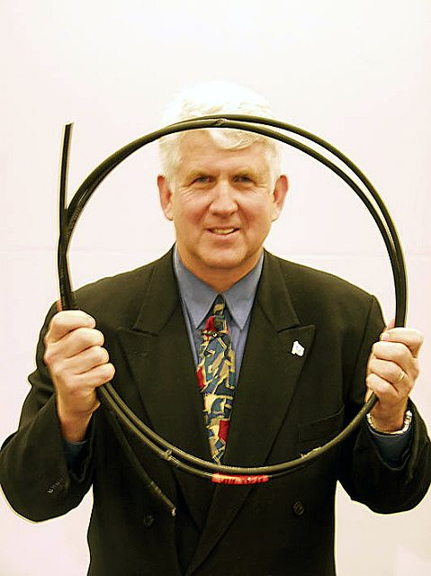
Internet
“I predict the internet will soon go spectacularly supernova and in 1996 catastrophically collapse.”
– Robert Metcalfe Inventor of Ethernet (Dec 1995)

Slide 16
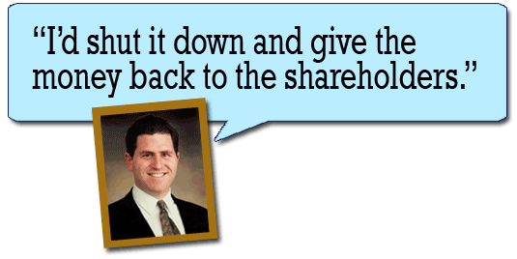
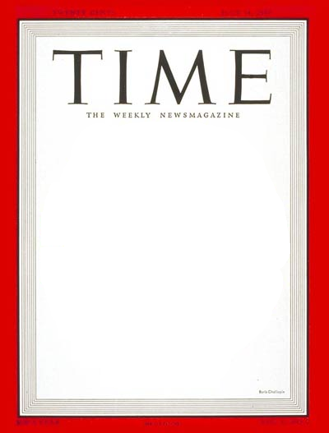
Apple
February 1996
“Apple [is] a chaotic mess without a strategic vision and certainly no future.”
MICHAEL DELL

Slide 17
“It is virtually certain that Google's stock will be highly disappointing to investors foolish enough to participate in its overhyped offering – you can hold me to that.”
– Whitney Tilson, American Investor (2004)
Google shares went public at $85 and multiplied in value 12-fold in 10 years

Slide 18
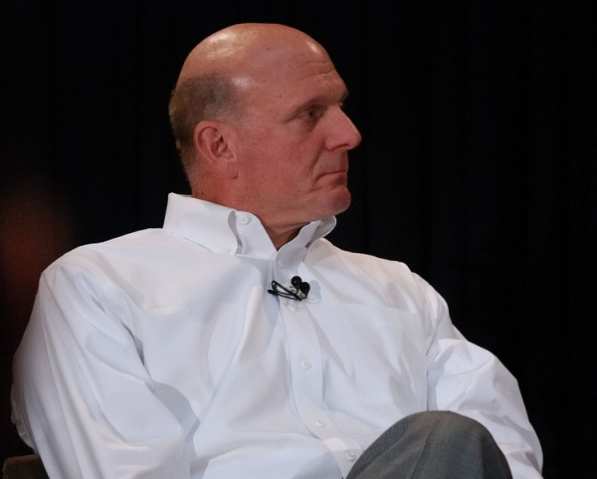
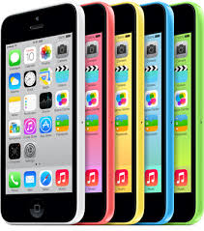
“There's no chance that the iPhone is going to get any significant market share. No chance.”
– Steve Ballmer, President of Microsoft (2007)

Slide 19
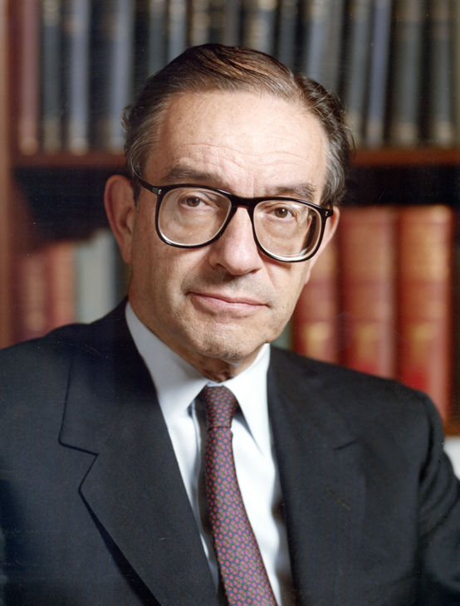
2008 Financial Crisis
Alan Greenspan, Chairman of Federal Reserve 1988-2006 denied for years that a speculative bubble was forming in the US real estate market.
By October 2008, he was admitting that he was in a state of “shocked disbelief” because “the whole intellectual edifice had collapsed.”

Slide 20
What is the source & nature of our colossal capacity for Ignorance?

Slide 21
The Double Wall of Ignorance
We live in the surface consciousness between a double wall
We are ignorant of the world around us
We judge others by the same norms, standards and values as we judge ourselves
We project our motives on others and fault them for our own weaknesses
We are equally ignorant of our own deeper selves
IGNORNACE

Slide 22
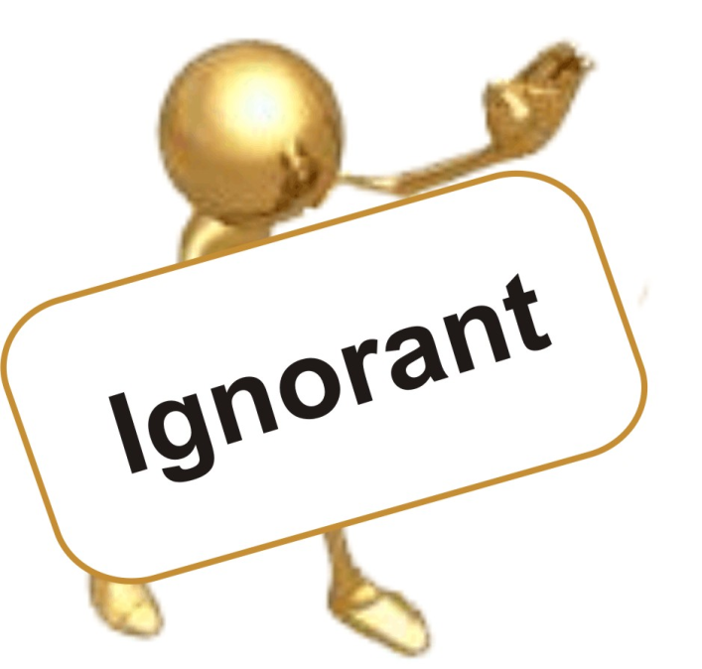
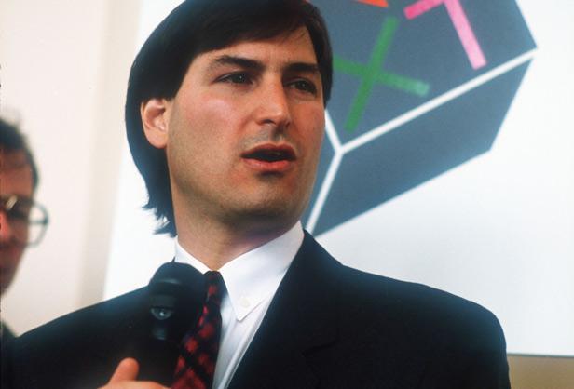
Ignorance of ourselves
Know thyself is not just a platitude. It is ultimate wisdom
Ego blinds us to our own weaknesses and defects
We are equally ignorant of our unexpressed capacities and unrealized potentials
Jobs thought his career was finished in 1985.

Slide 23
Ignorance in Space
Senses provide information only about what is going on immediately around us
Beyond that, we have to rely on instruments
To judge the world from our immediate surroundings or specific locale is a form of blindness
To be open to what is going on elsewhere and think how it can be done here is openness to knowledge

Slide 24
Ignorance in Time
Once a moment passes, it is lost & irretrievable
Memory is an indirect means of partial recall like a mirror, photo album, biography or history – usually distorted
Lessons relearned in the past have to be repeated, as 2008 repeated 1929
To learn a lesson after just one experience is very rare – extraordinary – 3M and Post It Notes
To learn from the experience of others is even more rare
Knowledge is to be conscious of the significance of our past experiences

Slide 25
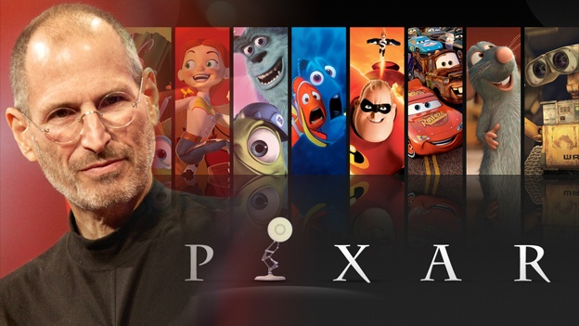
Ignorance of the Future
“Here where one knows not even the step in front.”
– Sri Aurobindo
We depend on imagination to anticipate the future
Steve Jobs wanted to sell Pixar just before launching Toy Story

Slide 26
Appearances can be deceiving
We know the world only indirectly and externally through the physical senses
Empiricism affirms indirect sensory experience as the basis for knowledge

Slide 27
Higher Mental Processes
Reason – coordinating intelligence – is our highest mental faculty
Reason mistakes ambiguous concepts & symbols for reality itself
Money is a symbol, not a thing
“It (mind) knows only its own analysis.” – Sri Aurobindo
Notes:
It mistakes ambiguous concepts and symbols for reality itself
Money is a symbol
Consciousness is a concept

Slide 28
Divide and Conquer
Division – mind knows by division -- Reductionism -- leads to exclusive concentration
Aggregation – mind reassembles parts to try to know the whole, but fails when applied to complex systems and living organisms e.g. health

Slide 29
Physicalism
Methodological naturalism gradually led to philosophical naturalism or physicalism
Mind extends its logic of material things to all reality
Physicalism considers only material things as fully real and regards mental phenomena & consciousness result from material interactions
Fortunately, Washington & FDR were not physicalists
Logic of the physical breaks down when applied to mind and emotions.
Ideas and emotions are not lost when given away

Slide 30
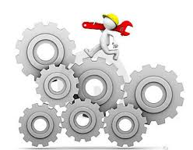
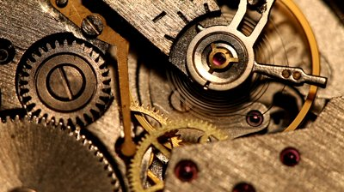
Mechanism
Mechanism is the natural counterpart of a worldview founded on reductionism and physicalism.
Mechanism regards all organizations, including living organisms and social organizations, as if they were inanimate machines composed of parts and driven by external forces.

Slide 31
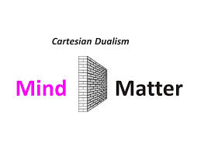
Great Divorce: Mind & Matter
Thinking mind knows by separation from the object of knowledge as impartial observer
Origin of the Cartesian dualism between Mind & Matter
Exclusive concentration on a part of reality creates ignorance
Severs the connection between objective external world and subjective psychological reality

Slide 32
“The Whole is Greater than the Sum of its Parts”
Systems Theory, holistic or ecological thinking view reality comprehensively as a whole consisting of interconnected and interdependent parts
Focus on relationships rather than separate individual elements
Permits systematic analysis of complex interactions between objects, points, activities and events
Systems theory replaced the metaphor of the machine as a closed system operating independently of the world around with the concept of physical organization as an open system in relation with its environment.
Tendency persists to view living organisms as complex mechanical systems

Slide 33
Contradictions are Complements
Dualism – mind sees things as mutually exclusive opposites
Greater truth is all oppositions are complementarities
All great scientific discoveries have involved reconciling apparently independent or contrary phenomena
Newton unified motion and rest by demonstrating that the same laws govern celestial motions & phenomena on Earth.
Maxwell unified electricity & magnetism as electromagnetism.
Einstein unified acceleration and gravity, space & time.
“Everything needs its opposite for its existence. The indivisible, whole being that the Individual is, is made complete when he accepts and integrates all aspects of his personality, realizing in the process that contradictions are complements.” – Carl Jung

Slide 34
Knowledge is to know that the Opposite of every truth is true
“All human thought, all mental man’s experience moves between a constant affirmation and negation; there is for his mind no truth of idea , no result of experience that cannot be affirmed, none that cannot be negated.”
– Sri Aurobindo

Slide 35
Insight and Intuition
Mind knows others by objective external contact.
Emotion knows by subjective inner contact.
Intuition knows by identification.
“It is by logic that we prove, but by intuition that we discover.”
— Henri Poincaré
“All human knowledge begins with intuitions, proceeds from thence to concepts, and ends with ideas.”
— Immanuel Kant
“I began to realize that intuitive understanding and consciousness was more significant than abstract thinking and intellectual logical analysis…Intuition is more powerful than intellect.”
— Steve Jobs
Notes:
“It is by logic that we prove, but by intuition that we discover.” — Henri Poincaré, Science and Method (1908)

Slide 36
Einstein on Intuition
“The intellect has little to do on the road to discovery. There comes a leap in consciousness, call it intuition or what you will, and the solution comes to you and you don’t know why or how.”
“The intuitive mind is a sacred gift and the rational mind is a faithful servant. We have created a society that honors the servant and has forgotten the gift.”
“There is no logical path leading to [the highly universal laws of science]. They can only be reached by intuition, based upon something like an intellectual love of the objects of experience.”

Slide 37
Mental & Intuitive Knowledge
The intellect perceives differences and understands reality in terms of mutually exclusive opposites. Intuition focuses on interconnections and relationship and the underlying unity that connects everything together.
Mind discovers finite laws and limits. Intuition uncovers the realm of Infinite potential where nothing is impossible. Future science will one day discover that Infinity is a practical concept
Mind discovers patterns of similarity and repetition in human history. Intuition perceives the underlying evolution of consciousness that is gradually emerging.
Ideas are the highest truth accessible to mind and it discovers that all mental truths are relative. Intuition affirms the truth of universal and eternal Values.

Slide 38
Knowledge for Accomplishment
Do not place faith in the mind’s externalized way of seeing
Consider other points of view, rather than judging solely by one’s own standard
Always remember that we do not know
Consider the whole, not merely the parts
Do not judge the future from the past
Give greater importance to intangible than material factors
“You can become whatever you believe you can become”
– Bhagavad Gita

